Slide 1

Insecure Cryptographic Storage- CWE 327
Sanad Masannat

Slide 2
What is Insecure Cryptographic Storage
Weak or outdated cryptography algorithms are used
Improper Key Handling
No hashing and/or salting used on passwords

Slide 3
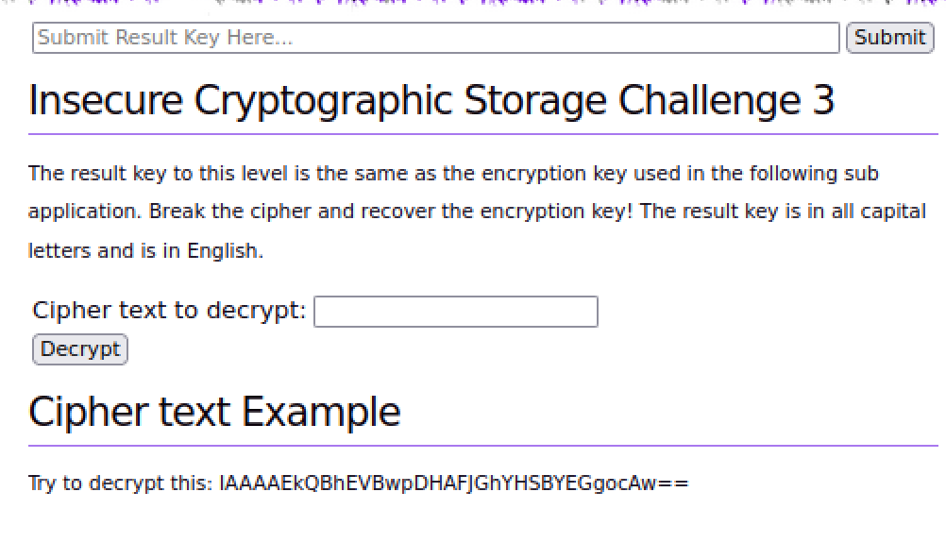
What was tested
What was Used
Security Shepherd Web Application
Insecure Cryptography Challenge 3
VM Environment
Python Code
Burp Suite

Slide 4
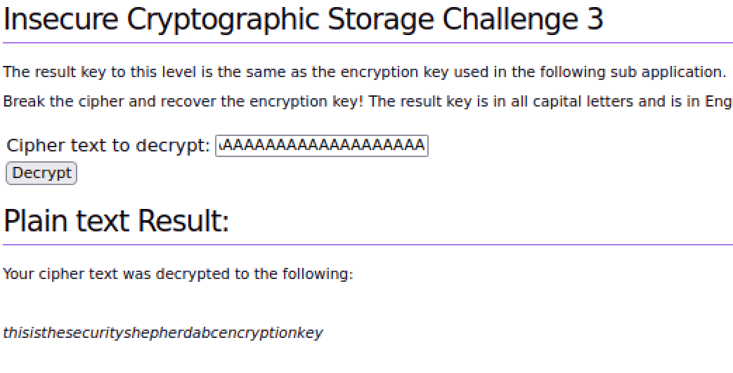
Test Process
Input given cipher text and make note of output
Put it through base64 decode on BurpSuite
Run python code to compare plaintext and cipher text
Input various strings and characters to see what is output
Input 55 A’s to get encryption key

Slide 5
Implications of this vulnerability
Severe Implications – CVSS Score of 9.1
Decryption of Sensitive Data
No Protection

Slide 6
Mitigation Recommendations
Avoid using XOR and cyclic keys
Avoid custom encryption
Use more secure encryption algorithms
Transient Keys
Proper Key Management
Use Salt and Hashes

